Slide 1


Slide 2

Cognos 11 Upgrade: Consumer Introduction
April 1, 2018
Office of Information Technology
Presented by Andrey Campos

Slide 3

Introduction
The University of La Verne is upgrading to Cognos 11 starting April 1, 2018. This change is driven by IBM stopping support for Cognos 10.
This presentation will provide an overview of the interface changes for Cognos reports consumers.

Slide 4
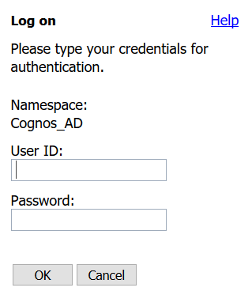

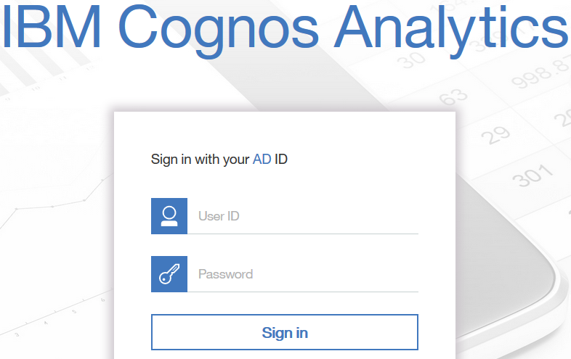
Sign-in Page
The new Sign-in page is shown below
The username and password remain the same as they were with Cognos 10, your Windows credentials.

Slide 5
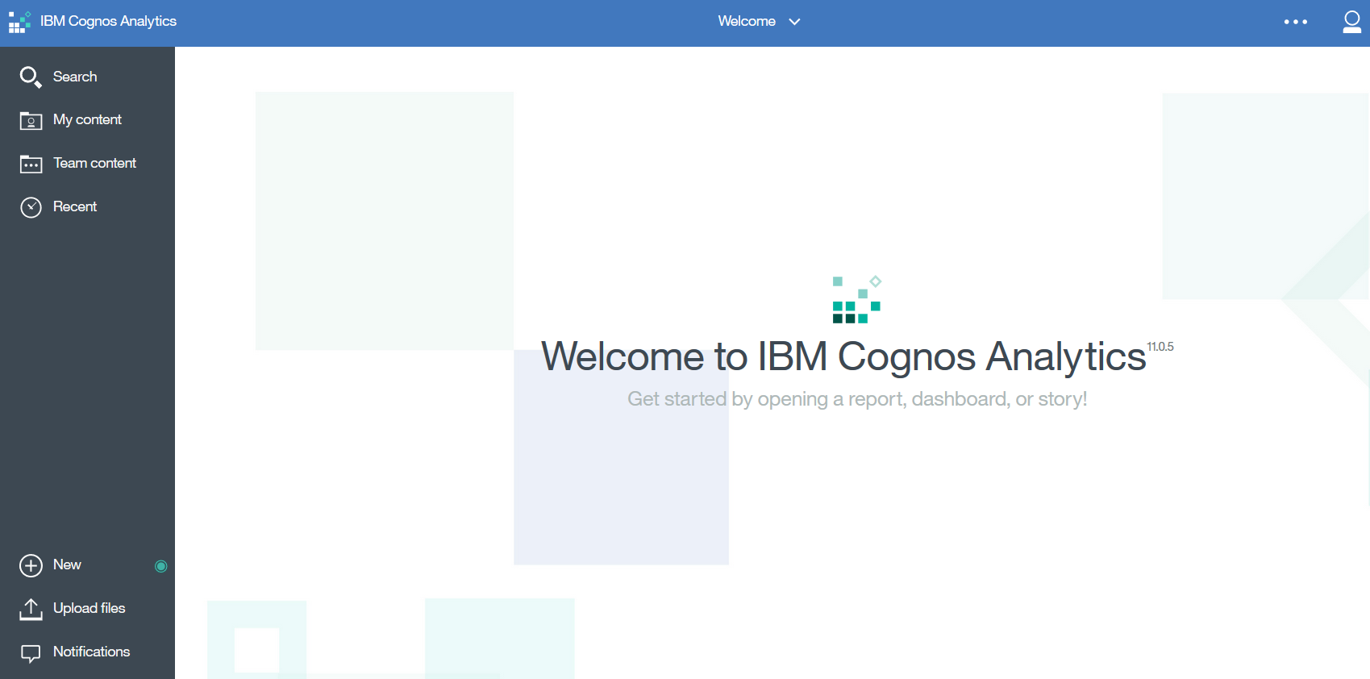
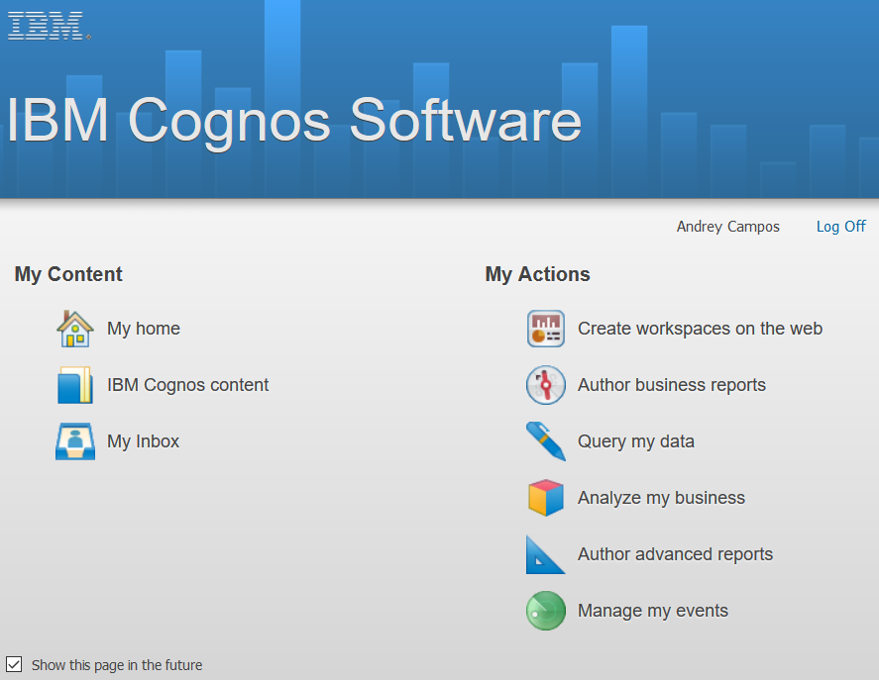
Content Page discontinued
Cognos 11 does not have a “My Content” page
Instead when an user signs in, the Welcome page is displayed.

Slide 6
Welcome Page
The Welcome Page is the main hub in Cognos 11.

Slide 7
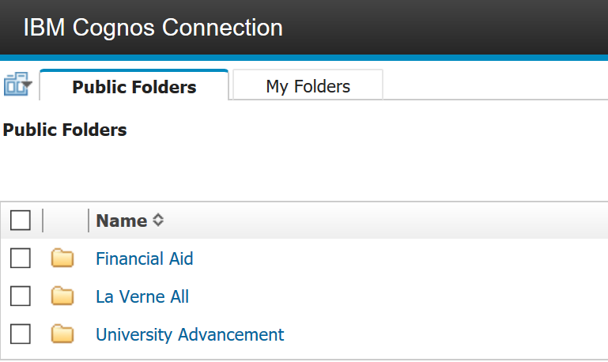
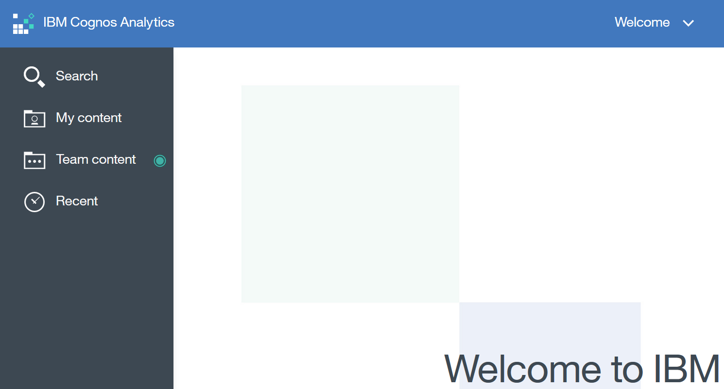
Browsing in Cognos 11
Cognos 11 does not have the same folder structure as the previous version. Instead there is a “My Content” for personal use and a “Team Content” for public use, replacing the “My Folders” and “Public Folders” respectively.

Slide 8
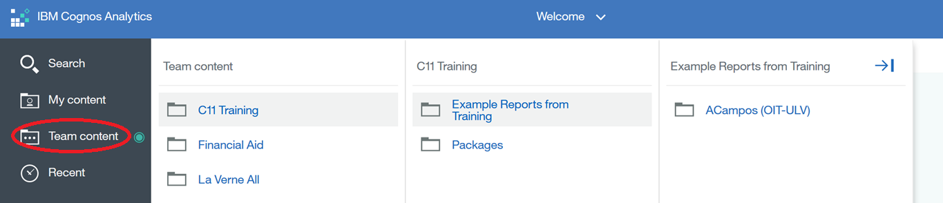
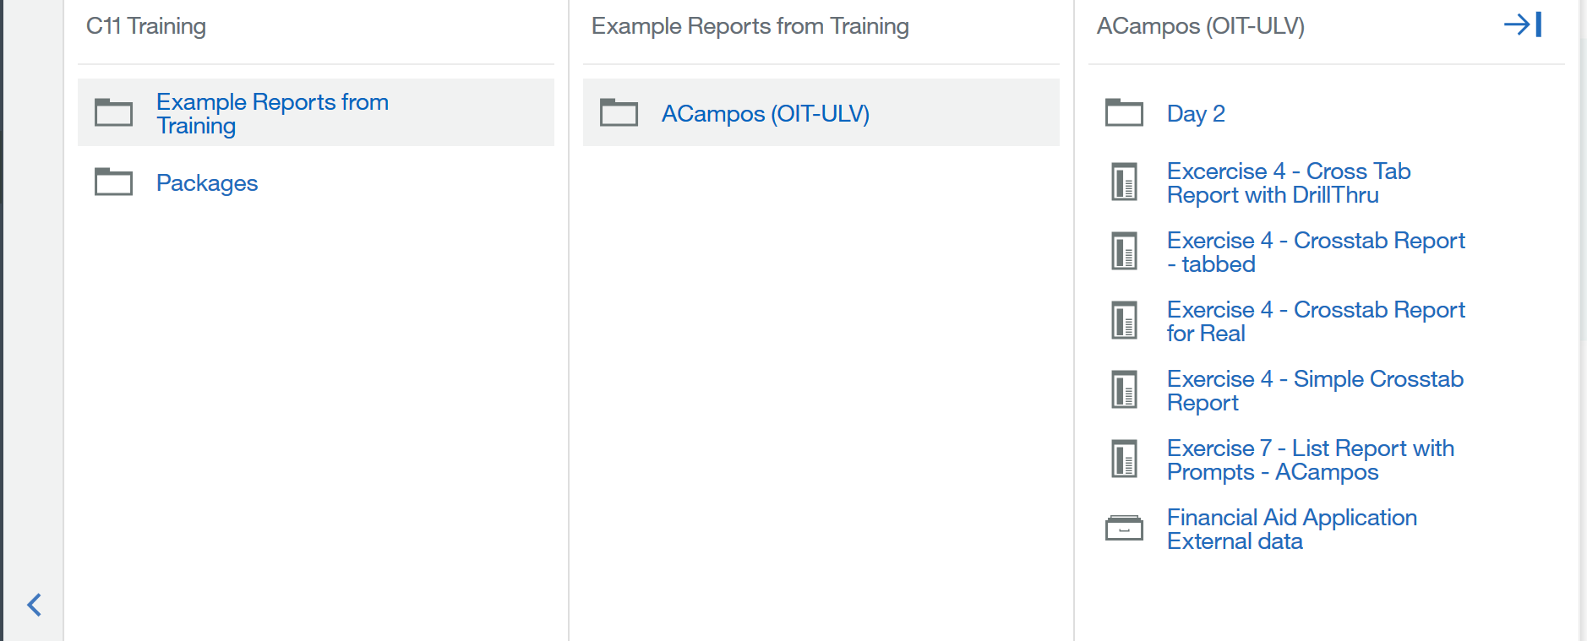
Navigation Panes
Cognos 11 uses expanding panes for content navigation, instead of the traditional folder interface. A single click on a pane name will expand it.
The interface will display 3 levels of panes at a time. If more than 3 levels are expanded a new pane with a left arrow will appear to allow the user to go back a pane level.
Here are examples of expanding the Team Content pane 3 and 4 levels.
3 levels of navigation
4th level of navigation with the left arrow displayed

Slide 9



Cognos 11 Icons
Here are the main Cognos 11 icons used in the navigation panes.
Folder
Report
Reporting Package

Slide 10
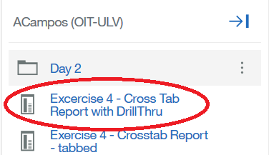
Running a report
Reports in Cognos 11 can be run by simply clicking on the report name. Depending on the report configuration the report will run in the same browser window or a new browser window.

Slide 11
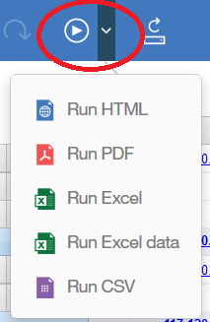
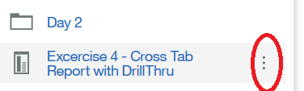
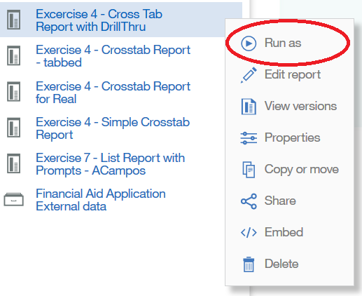
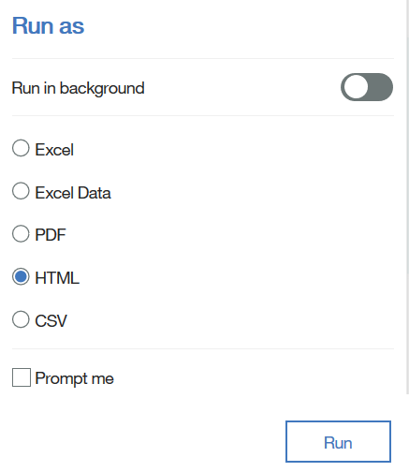
Running a report in different formats
Reports in Cognos 11 can be created in different formats, besides the web-based version.
There are a couple of ways to accomplish it:
If the report has been run in the browser, it can be created in a different format by clicking on the triangle highlight in the left.
If the report has not been run then it can be run from the navigation pane by following the steps below:

Slide 12

Thank you
Place text here.

